Slide 1
Chapter 2: Operating-System Structures

Slide 2
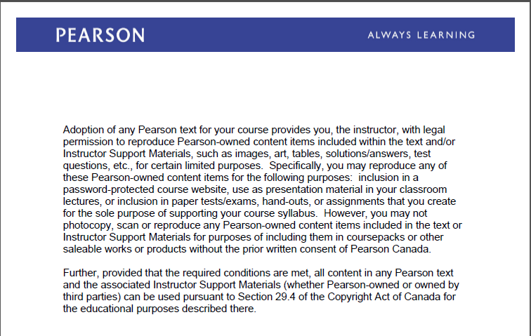
Text Book Slides – Copy Right

Slide 3
Chapter 2: Operating-System Structures
User Operating System Interface
Operating System Design and Implementation
Operating System Structure
Operating System Generation

Slide 4
User Interface

Slide 5
User Operating System Interface - CLI
CLI or Command Line interpreter allows direct command entry. sometimes implemented in kernel, sometimes by systems program
Shell is a program that interprets commands
Primarily fetches a command from user and executes it
Most common shells in Linux are: sh , Bash, csh
Each shell has its own environment (system variables) e.g PATH, SHELL, PS1, USERNAME, HOSTNAME ... etc
These variables can be accessed using env command or
echo $VARIABLE-NAME

Slide 6
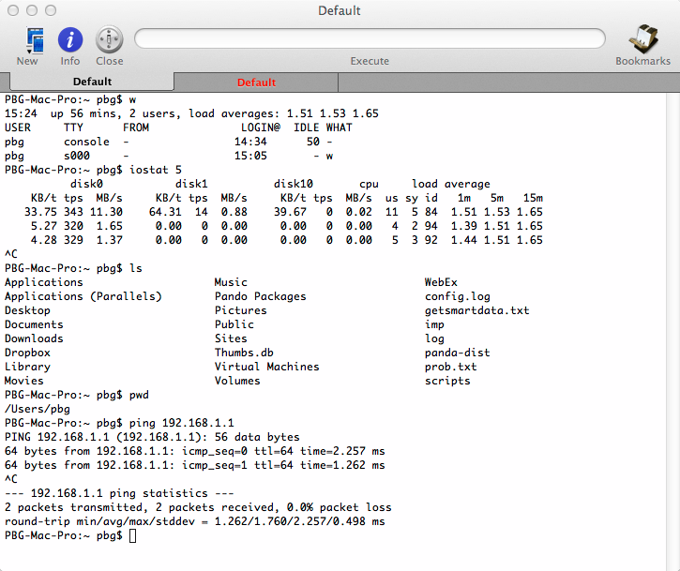
Bourne Shell Command Interpreter

Slide 7
User Operating System Interface - GUI
User-friendly desktop metaphor interface
Usually mouse, keyboard, and monitor
Icons represent files, programs, actions, etc
Various mouse buttons over objects in the interface cause various actions (provide information, options, execute function, open directory (known as a folder)
Many systems now include both CLI and GUI interfaces
Microsoft Windows is GUI with CLI “command” power shell
Apple Mac OS X is “Aqua” GUI interface with UNIX kernel underneath and shells available
Unix and Linux have CLI with optional GUI interfaces (CDE, KDE, GNOME)

Slide 8
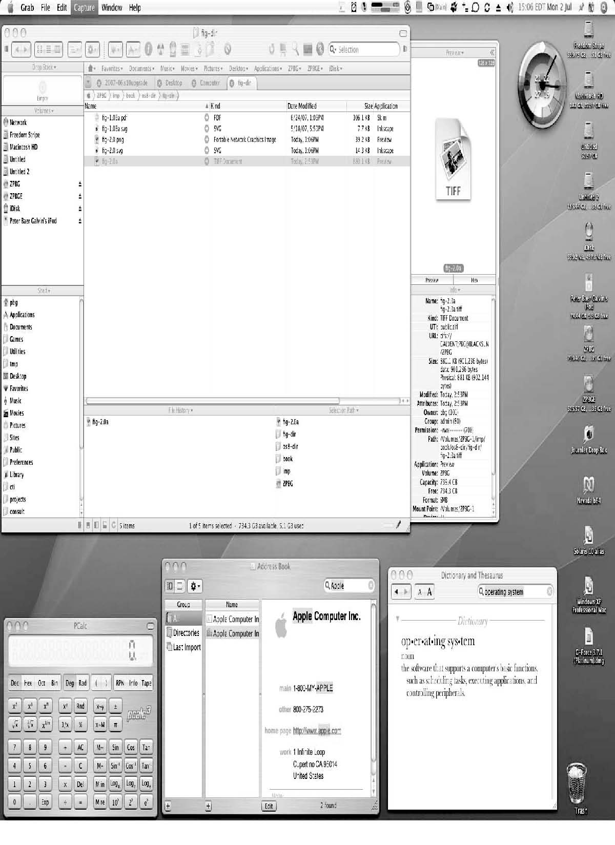
The Mac OS X GUI

Slide 9
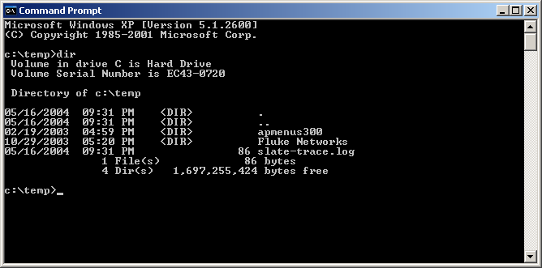
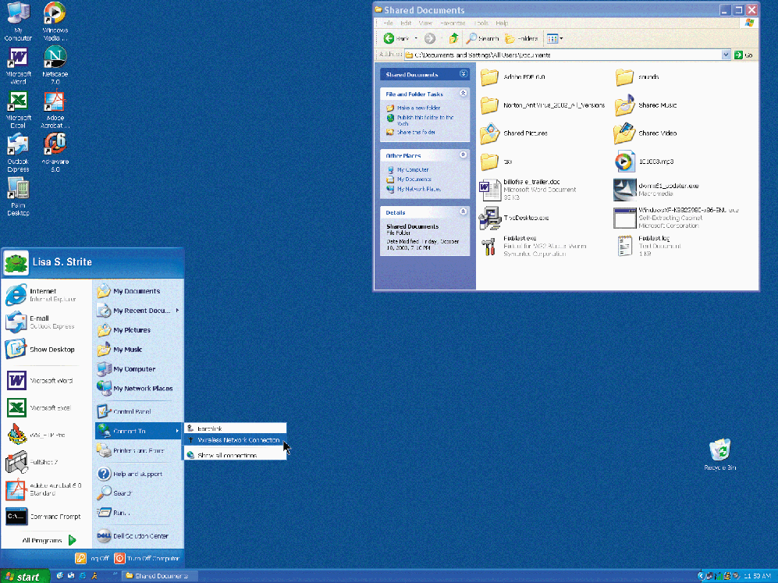
Windows User Interface
Command-Line
GUI
Notes:
“Microsoft product screen shot(s) reprinted with permission from Microsoft Corporation.”

Slide 10
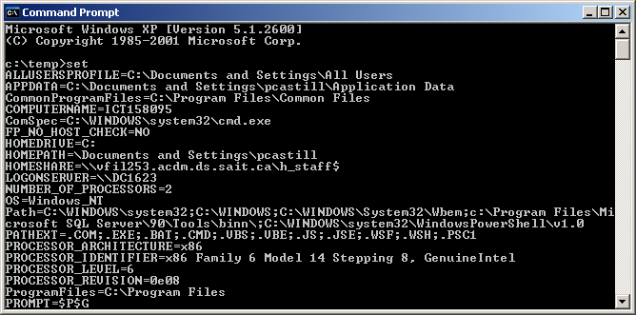
Set command
Notes:
“Microsoft product screen shot(s) reprinted with permission from Microsoft Corporation.”

Slide 11
Windows Management Instrumentation (WMI)
WMI is the core management-enabling technology for Windows
Built into Windows 7 and Windows Server 2008
Originally released in 1998 as an add-on with Windows NT 4.0 Service Pack 4
Almost all Windows resources can be accessed, configured, managed, and monitored via WMI
WMI is an implementation of Web-Based Enterprise Management (WBEM),
WMI scripting library is implemented in a single DLL (Dnamed wbemdisp.dll, that resides in %SystemRoot%\system32\wbem directory
WMI was added to address two short-comings in previous versions of NT:
Remote monitoring & management
Scripting - PowerShell

Slide 12
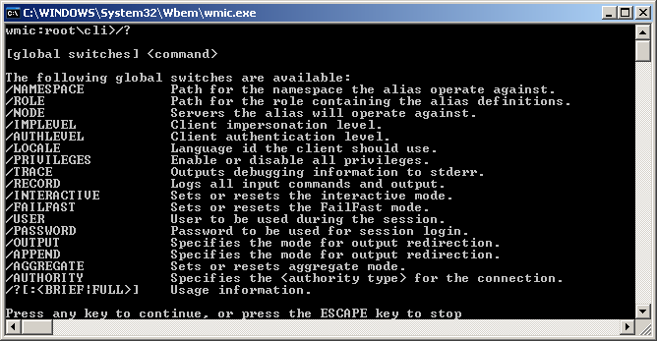
WMIC Command-Line
WMI Command-line
You can use wmic.exe to perform common WMI tasks from the command line.

Slide 13
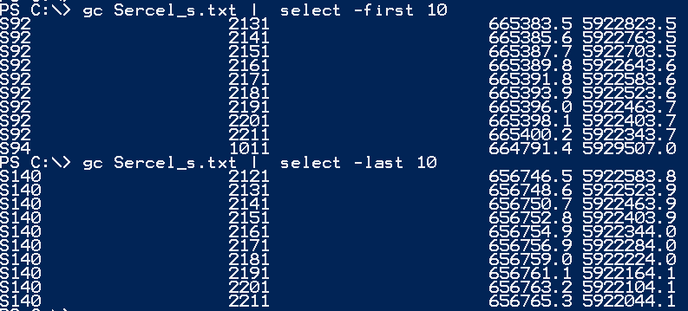
Windows Power Shell

Slide 14
Operating System Operations Kernel and User mode

Slide 15
Kernel-Mode vs User-Mode
To ensure the integrity of the OS, the designers separated it into two modes: Kernel and User Mode
Mode bit provided by hardware. It distinguishes when system is running in user code mode bit=1or kernel code mode bit =0
Kernel mode (supervisor, kernel, privileged, system mode). Kernel space is strictly reserved for running the kernel, kernel extensions, and most device drivers
Can execute all machine instructions
Can reference all memory locations
Some instructions designated as privileged, only executable in kernel mode
User mode User space is the memory area where all user mode applications work and this memory can be swapped out when necessary.
Can only execute a subset of instructions
Can only reference a subset of memory
locations

Slide 16
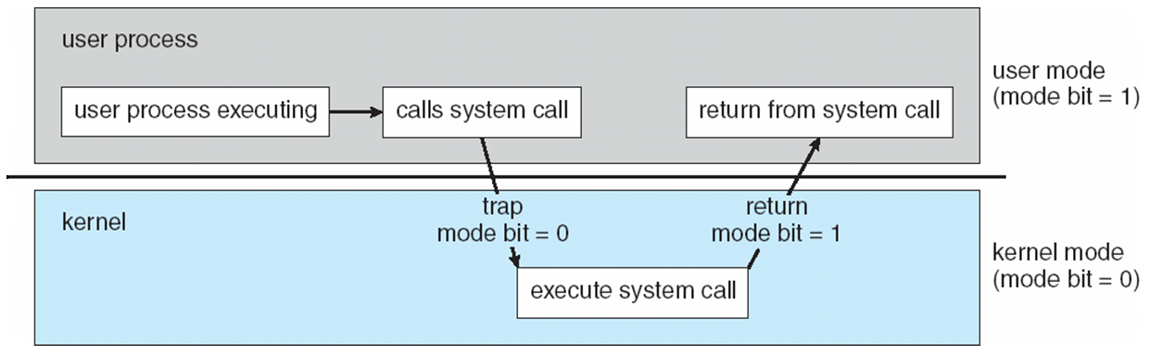
Transition from User to Kernel Mode
Timer to prevent infinite loop / process hogging resources
OS traps instruction and validates arguments to system calls
Set interrupt after specific period
Operating system decrements counter
When counter zero generate an interrupt
Set up before scheduling process to regain control or terminate program that exceeds allotted time

Slide 17
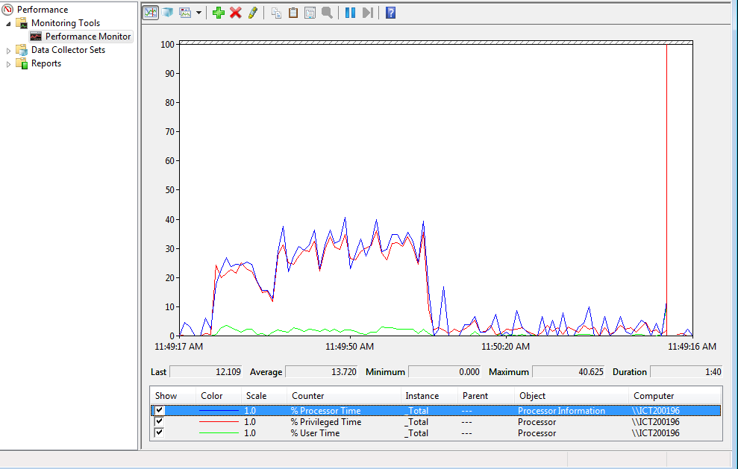
Privilege and User Time
Processor Time
Privileged Time
User Time

Slide 18
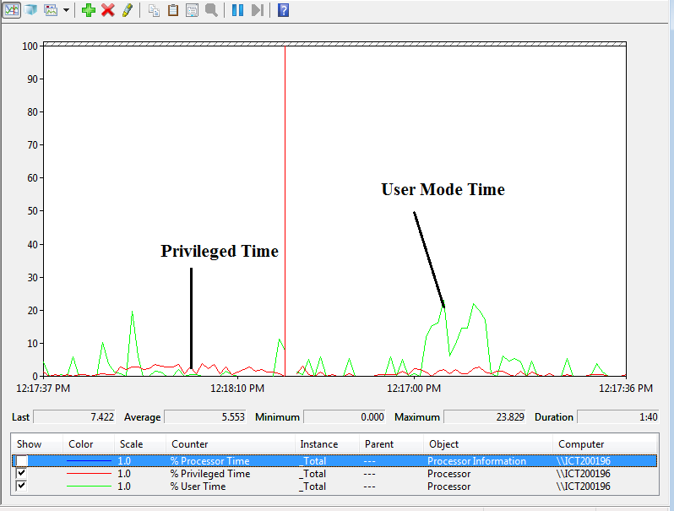
Privileged and User Time

Slide 19
User Mode vs Kernel Mode
Application
Program
Application
Program
Application
Program
User Mode
Kernel Mode
System Services
File System
Memory Management
Processor Scheduling and IPC
Network Stack
I/O Management and Device Drivers
Hardware

Slide 20
Kernel Architectures
Application
Windows
User Mode
Kernel Mode
System Services
Device
Drivers
Process Management, Memory Management,
I/O Management, etc.
Win32
Windowing
Hardware Dependent Code
Application
Linux
X-Windows
User Mode
Kernel Mode
System Services
Process Management, Memory Management,
I/O Management, etc.
Device
Drivers
Hardware Dependent Code

Slide 21
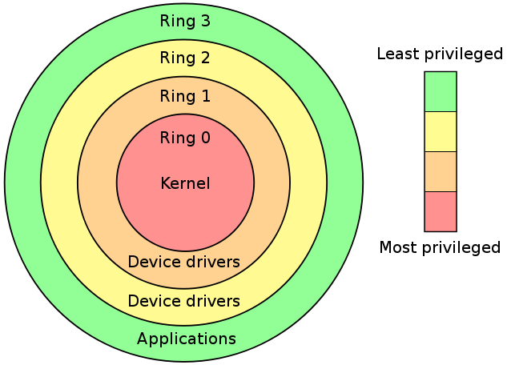
Layered Operating system
Notes:
Permission is granted to copy, distribute and/or modify this document under the terms of the GNU Free Documentation License, “

Slide 22
Operating system structure

Slide 23
Operating System Design and Implementation
User goals and System goals
User goals – operating system should be convenient to use, easy to learn, reliable, safe, and fast
System goals – operating system should be easy to design, implement, and maintain, as well as flexible, reliable, error-free, and efficient

Slide 24
Implementation
Much variation
Early OSes in assembly language
Then system programming languages like Algol, PL/1
Now C, C++
Actually usually a mix of languages
Lowest levels in assembly
Main body in C
Systems programs in C, C++
Scripting languages like PERL, Python, shell scripts
More high-level language easier to port to other hardware
But slower
Emulation can allow an OS to run on non-native hardware

Slide 25
Kernel Implementation
1. Monolithic Kernel
All operating system’s functions & drivers are compiled into one large kernel
Fast & efficient
More work to accommodate hardware changes
Changes in the code can damage the kernel
https://en.wikipedia.org/wiki/Monolithic_kernel
2. Microkernel
Kernel has minimal functionality
Small kernel requires small changes
Majority of functions are external code called modules
3. Modules – loadable kernel modules
The most common design in modern OS
4. Hybrid Structures. It combines above structures
Monolithic, Microkernel and Modules Kernel
https://en.wikipedia.org/wiki/Monolithic_kernel
Notes:
Is Windows a microkernel-based OS?
No – not using the academic definition (OS components and drivers run in their own private address spaces, layered on a primitive microkernel)
All kernel components live in a common shared address space
Therefore no protection between OS and drivers
Why not pure microkernel?
Performance – separate address spaces would mean context switching to call basic OS services
Most other commercial OSs (Unix, Linux, VMS etc.) have the same design
But it does have some attributes of a microkernel OS
OS personalities running in user space as separate processes
Kernel-mode components don't reach into one another’s data structures
Use formal interfaces to pass parameters and access and/or modify data structures
Therefore the term “modified microkernel”

Slide 26
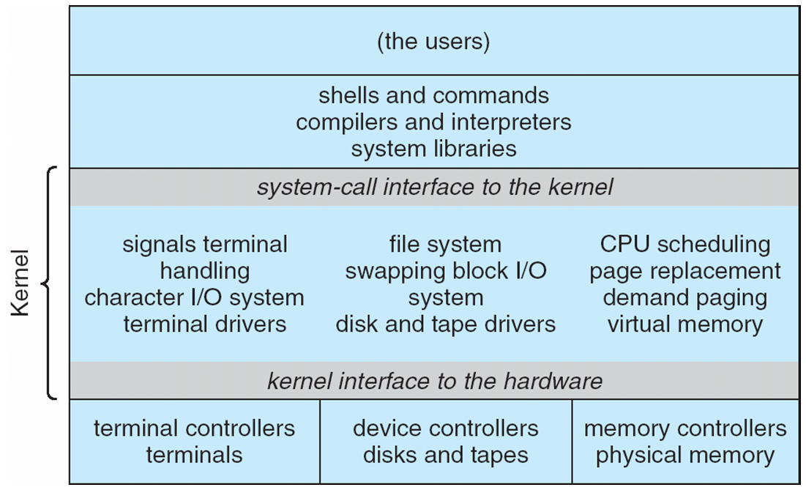
Monolithic Unix System Structure

Slide 27
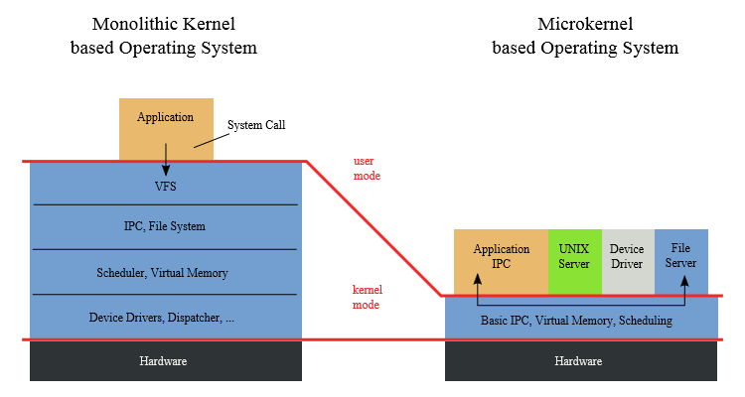

Monolithic and Microkernel

Slide 28
Microkernel System Structure
Microkernel architecture removes all nonessential components from the kernel. It has small kernel.
Microkernel implements message passing technique to communicate programs running in user mode
Benefits:
Easier to extend the operating system
Easier to port the operating system to new architectures
More reliable (less code is running in kernel mode)
More secure
Disadvantage:
Performance is affected due to increased system-function overhead. More traps needed due to message passing
E.g. Darwin kernel component of macOs and iOs and QNX Neutrino real time operating system provides services for message passing

Slide 29
Microkernel System Structure

Slide 30
Modules
Most modern operating systems implement loadable kernel modules
Main routines (modules) can be built directly into the kernel and other modules can be loaded dynamically while the kernel is running
Each module is loadable as needed within the kernel
It uses object-oriented approach
Each core module is separated
Each module talks to the others over known interfaces
Linux implements loadable kernel modules for drivers and file systems
Linux commands to manage modules:
lsmod --- displays current loaded kernel modules
insmod --inserts a module into the kernel
rmmod – remove module from kernel

Slide 31
Hybrid Systems
Hybrid kernel structures combines multiple approaches to address performance, security, usability needs. The following are examples of hybrid systems:
Linux and Solaris are monolithic because the OS is in a single address space but they are also modular kernels because modules can be loaded dynamically when needed.
Windows is mostly monolithic and layer kernel for different subsystems
Apple Mac OS X has a hybrid structure: Layers and Modules
It is a layered system. Aqua UI , Services and Cocoa programming environment and kernel environment
The bottom layer consists of a I/O kit and dynamically loadable modules (called kernel extensions)

Slide 32
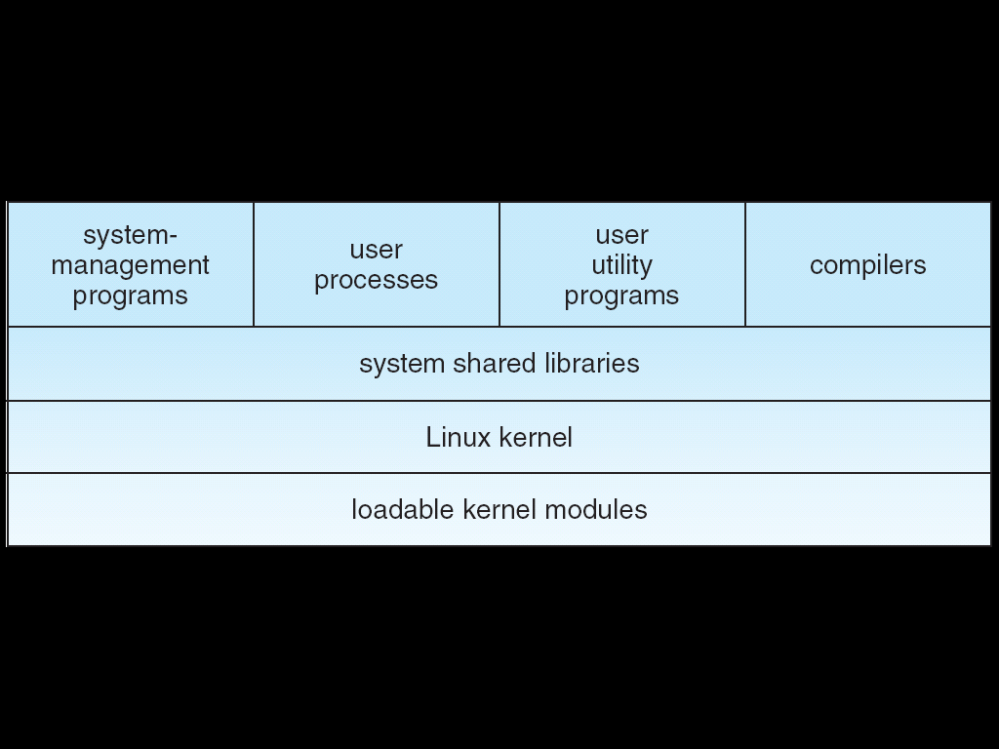
Linux Kernel
Linux /usr/src directory contains the kernel source, header-files and documentation.

Slide 33
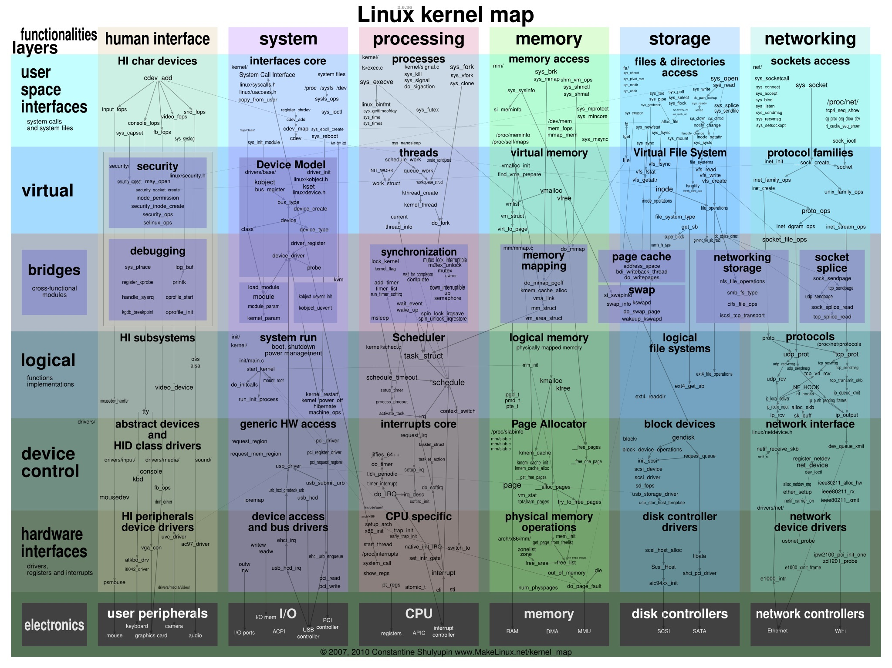
Linux Kernel
http://i.imgur.com/4sftcoo.jpg

Slide 34
Windows -Design Principles
Windows implements layered architecture with loadable drivers for I/O and file systems. Drivers can be added dynamically while the system is running.
Extensibility —Executive, which runs in protected mode, provides the basic system services
On top of the executive, several server subsystems operate in user mode
Modular structure allows additional environmental subsystems to be added without affecting the executive
Portability — Windows 7 and 10 can be moved from one hardware architecture to another with relatively few changes
Written in C and C++
Processor-specific portions are written in assembly language for a given processor architecture (small amount of such code).
Platform-dependent code is isolated in a dynamic link library (DLL) called the “hardware abstraction layer” (HAL)

Slide 35
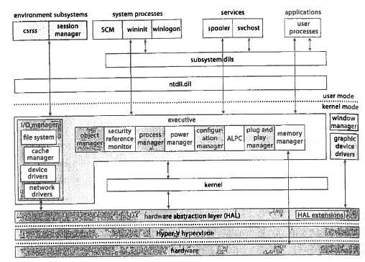
Depiction of Win 10 Architecture

Slide 36
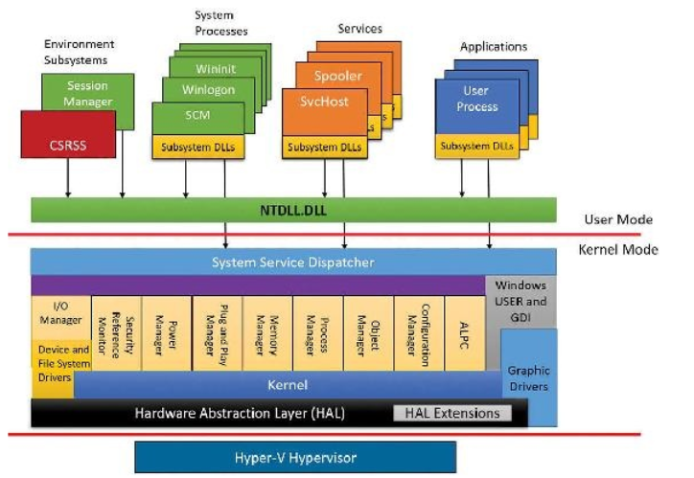
Windows Architecture

Slide 37
Hyper-V Hypervisor
Hypervisor is the first component initialize with virtual secure mode (VMS ) enabled.
Hypervisor is used to provide hardware virtualization features for running separate virtual machines and to provide virtual trust levels (VTL)
In VMS mode the layered privileged system has two implementations:
Normal World – VTL 0
Secure World – VTL 1
Within these worlds we find user mode and kernel mode

Slide 38
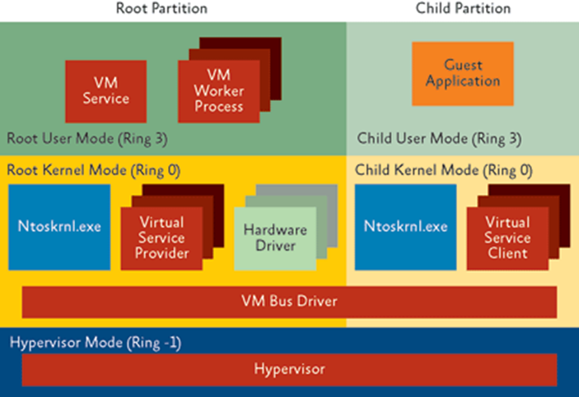
Hyper-V Architecture

Slide 39
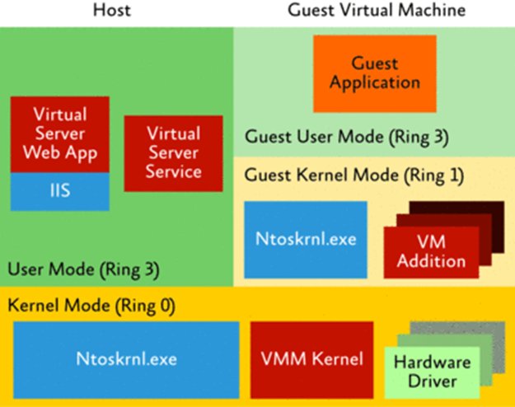
Host Machine Virtualization

Slide 40
Mac OS X Structure

Slide 41
iOS
Apple mobile OS for iPhone, iPad
Structured on Mac OS X
Does not run OS X applications natively
Also runs on different CPU architecture (ARM vs. Intel)
Cocoa Touch Objective-C API for developing apps
Media services layer for graphics, audio, video
Core services provides cloud computing, databases
Core operating system, based on Mac OS X kernel

Slide 42
Android
Developed by Open Handset Alliance (mostly Google)
Open Source
Similar stack to IOS
Based on Linux kernel but modified
Provides process, memory, device-driver management
Adds power management
Runtime environment includes core set of libraries and Dalvik virtual machine
Apps developed in Java plus Android API
Java class files compiled to Java bytecode then translated to executable that runs on Dalvik VM
Libraries include frameworks for web browser (webkit), database (SQLite), multimedia, smaller libc

Slide 43
Android Architecture

Slide 44
Text Book Slides – Copy Right

Slide 45
End of Chapter 2

